Slide 1
CANON LAW UPDATE
Marriage & Annulments

Slide 2
PART ONE:
The Canon Law of Marriage

Slide 3
Who can marry in the Church?
One man and one woman, at least one of whom is a baptized Latin Catholic, who:
Are properly disposed
Have fulfilled required preparation
Are free from impediments
Have the required intentions

Slide 4
Proper Disposition: Preparation
Required Preparation in the Diocese of Erie
Pre-Marital inventory
DO NOT set wedding date until sure of parties’ freedom to marry!
Formation Process (Pre-Cana, Engagement Encounter, Nova)
FOCCUS
Pastoral meetings, beginning 6 months prior to wedding
Pre-Marital Inventory: Required documents
M-A
2 M-B’s (For Non-Catholics and for Catholics unknown to you)
Baptismal certificate for Catholics (within 6 months with notations)
Proof of formation process
Marriage license

Slide 5
Proper Disposition: Impediments
Disparity of worship
Catholic + Non-Baptized
Need dispensation
Prior bond
ANY prior marriage
Proof of death or annulment needed
Perpetual physical impotence
NOT infertility
Cannot be dispensed
If in doubt, proceed with marriage

Slide 6
Not impediments but act like them:
Mixed Marriage
Catholic + baptized Non-Catholic
Need permission
Serious psychological or personality disorders
Need letter from doctor/therapist
Force or fear
“Shotgun wedding”
Premarital pregnancy
Need counseling
Condition
Prenuptial agreement
Only if indicates intention against permanence

Slide 7
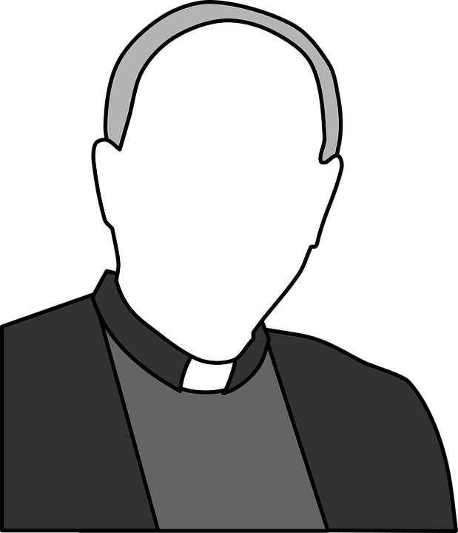
Who is responsible for preparing couple for marriage?
Pastor of Catholic party/parties responsible for preparation
Pastor of parish where marriage will be celebrated responsible for ensuring required preparation is complete before allowing marriage in his parish
Marriage file & record kept at parish where marriage takes place

Slide 8
Required Intentions
Marriage is a lifelong, exclusive partnership of the whole life ordered to the good of the spouses and the procreation and education of children that, among the baptized, Christ has raised to the dignity of a sacrament.
Permanence
Exclusivity/Fidelity
Good of the spouses
Procreation
Sacramentality (among baptized)
Parties need to understand and intend these things or, at least, not exclude them from their consent.

Slide 9
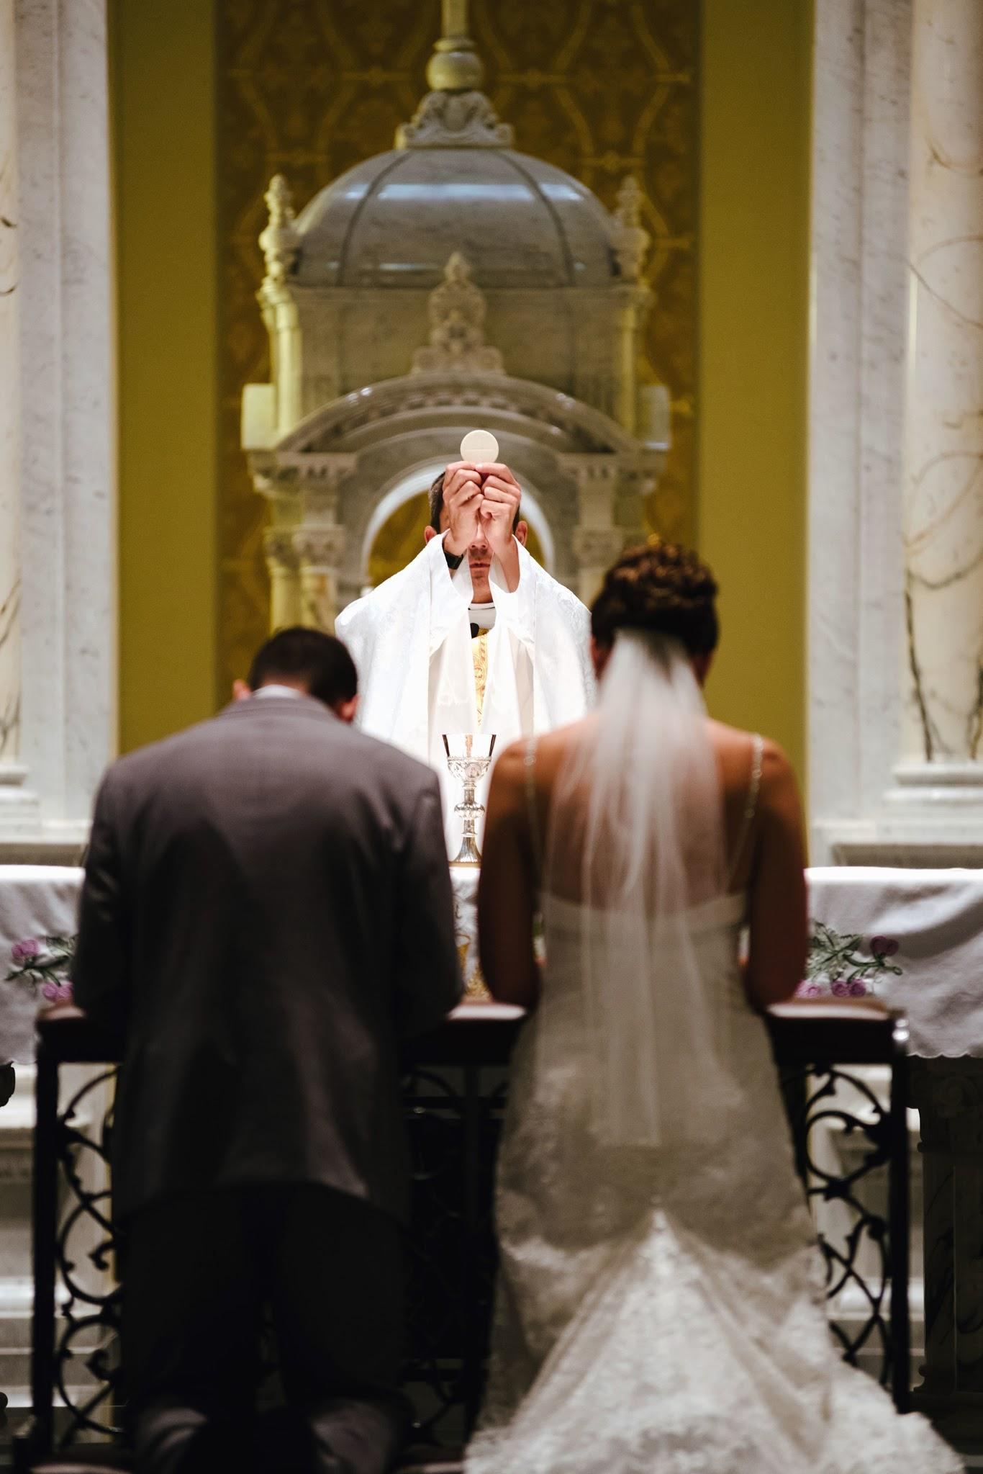
What is the form of marriage?
Parties marry each other
They are the ministers of marriage
Authorized priest or deacon assists them by
Asking for and
Receiving consent/vows
Of both parties
Before two witnesses
Can be dispensed by local ordinary
Mixed or interfaith marriage

Slide 10
Who is authorized to assist at marriages?
Bishop in his diocese
Vicar General in his diocese
Episcopal Vicars in their vicariate
Pastors/Parish administrators in their parish
Parochial Vicars in their parish, unless assignment letter states otherwise
Other priests and deacons can be delegated by the local ordinary or pastor of the parish where the marriage is celebrated.

Slide 11
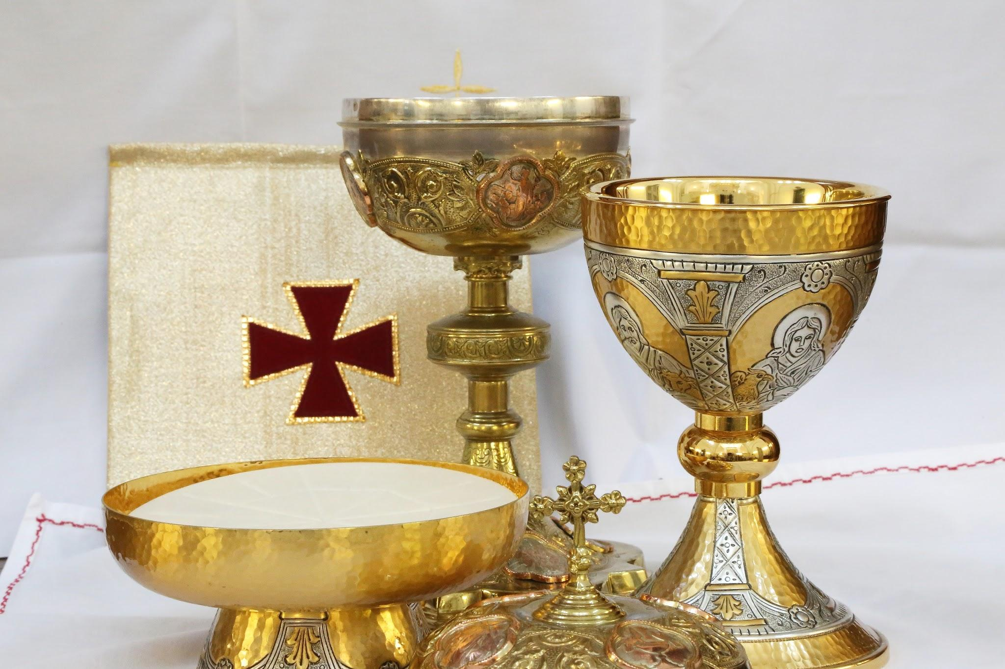
Within Mass or Without Mass?
Between 2 Catholics
Within Mass is recommended
Mixed Marriage
Without Mass is required
Bishop can give permission for Within Mass
Interfaith Marriage
Order of Celebrating Marriage between a Catholic and a Catechumen or Non-Christian is required

Slide 12
Where are marriages to be celebrated?
Marriages are to be celebrated in the parish church of one of the Catholic parties.
Pastor can grant permission for marriage to take place in a secondary church or in another parish.
Local Ordinary can grant permission for marriage to take place outside a Catholic church (e.g. Protestant church in a mixed marriage).
This permission is NOT granted for marriages celebrated according to canonical form

Slide 13
When can marriages be celebrated?
Marriages can be celebrated any day but Sunday, Good Friday, and Holy Saturday
Bishop can grant permission for Sunday wedding

Slide 14
PART TWO:
Annulments

Slide 15
Who needs an annulment?
ANYONE seeking to marry in the Church who is bound by a prior marriage and whose ex-spouse is still alive
ANYONE seeking to celebrate the sacraments of initiation who is in an apparently invalid marriage due to prior bond

Slide 16
What is an annulment?
An annulment is a declaration by an authorized tribunal that a marriage is legally null, without legal effect, in the Church.
The parties are therefore not bound by that marriage
They are free to enter a new marriage or validate an existing civil marriage in the Church
An annulment does NOT:
Assert that a marriage never happened
Have any effects in civil law
Have any effects on the legitimacy of children
Make any judgment about a person’s moral or religious quality

Slide 17
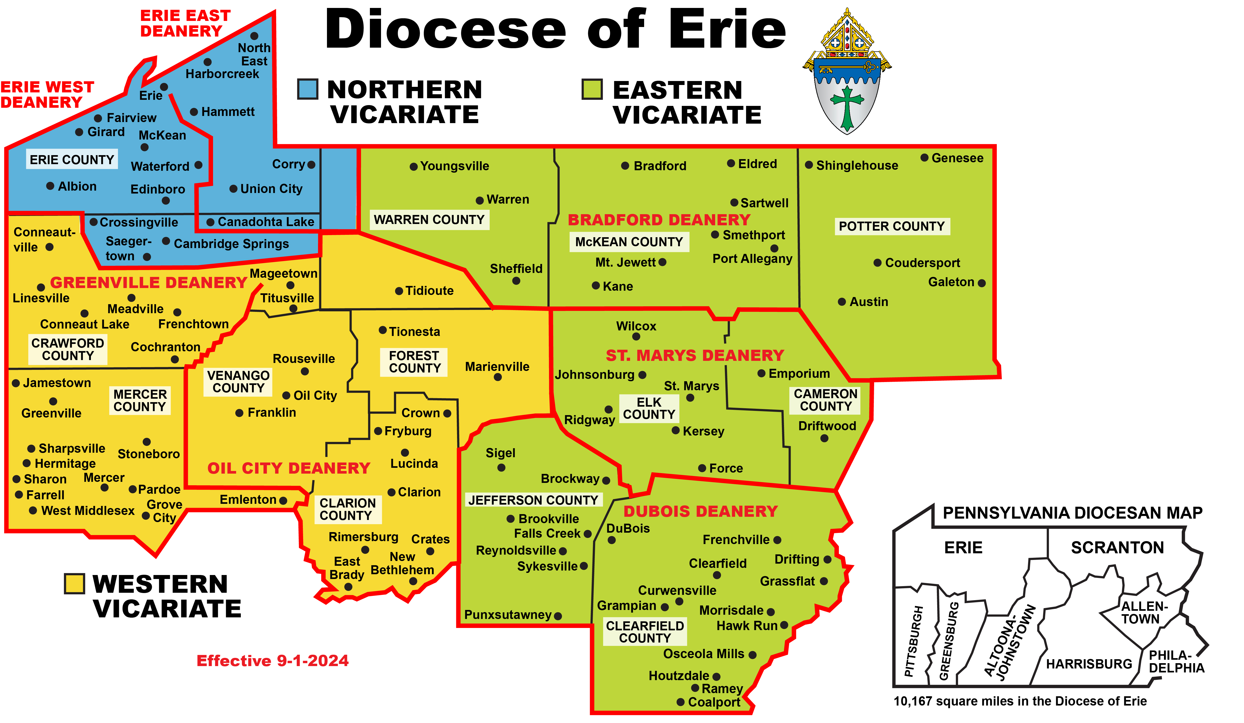
Where can a person apply for an annulment?
A person can apply, or petition, for an annulment at any authorized, or competent, tribunal
Tribunal is competent if:
Either party lives in that diocese, permanently or temporarily
Marriage took place in that diocese
Most witnesses live in that diocese

Slide 18
When can a person apply for an annulment?
A person can petition for an annulment when:
It is established that conjugal life cannot be restored (after civil divorce)
There is a need to determine the person’s marital status in the Church

Slide 19
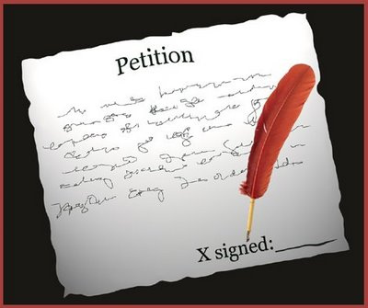
How does a person apply for an annulment?
Persons seeking an annulment must submit a completed petition, together with the required documents, to a competent tribunal
Priest, deacon, or trained lay minister should complete the petition with the person and serve as notary

Slide 20
Which petition?
Use Lack of Canonical Form petition when:
At least one of the parties was Catholic at the time of the wedding
The wedding took place outside of the Catholic Church
With no dispensation from form
And marriage was never validated or sanated after the wedding
Use the petition for a Formal Case for ALL other situations.

Slide 21
What is the annulment process?
The determination of the nullity of a marriage is an act of legal judgment, so the process is a judicial process, or trial
Nullity must be proven by Petitioner
By means of various documents (the acts of the case)
Declarations of the parties
Testimony of witnesses
Other documents (e.g. psychological records)
The standard of proof is moral certitude of the nullity of the marriage
Beyond a reasonable doubt
Based purely on the acts of the case
Weighed according to rules of evidence

Slide 22
What makes a marriage null?
A marriage is null if something essential to entering the legally binding contract of marriage was missing when the contract was “signed” - the exchange of vows/consent
Fatal flaw in:
Parties (impediments)
Formalities (canonical form)
Only applies to Catholics
Consent
Object
Act

Slide 23
Grounds for nullity
Flaw in the object of consent
Simulation
Total (exclude marriage itself)
Partial (exclude required intention)
Flaw in the act of consent
Grave defect of discretion of judgment
Psychological inability to evaluate and freely choose marriage (e.g. personality disorder)
Incapacity to fulfill obligations of marriage
Can evaluate and choose marriage, but can’t meet its demands (e.g. drug addiction)

Slide 24
How do I know a marriage has been declared null?
An Affirmative decision means that the marriage has been declared null
If no appeal is made within 15 days after an Affirmative decision is made known to the parties, it takes effect
Final letter provides proof of freedom to marry
Include copy of that letter in marriage file if person seeks to marry

Slide 25
QUESTIONS?

